Slide 1
REALCHEM
Real-world emission Experiments and comprehensive Assessment of Low-carbon fuels: towards Clean Hard-to-Electrify transport Modes

Slide 2
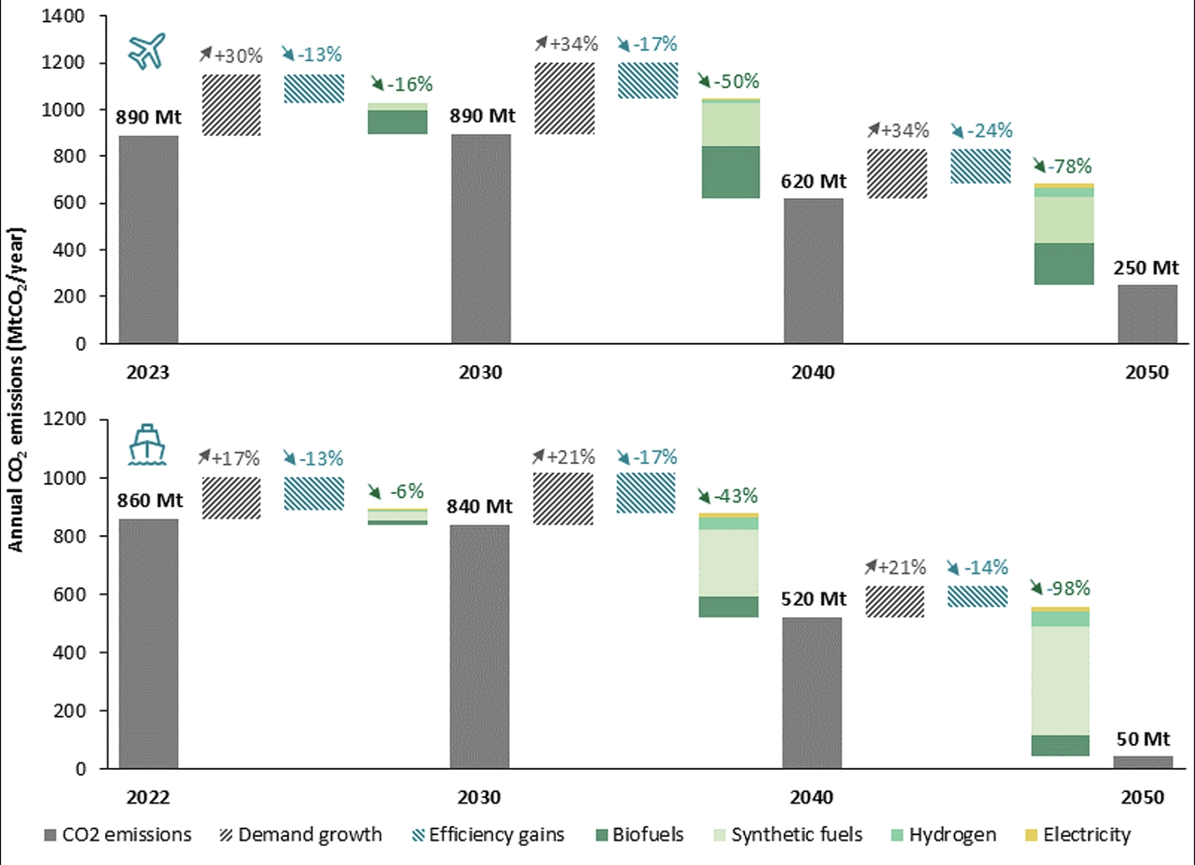
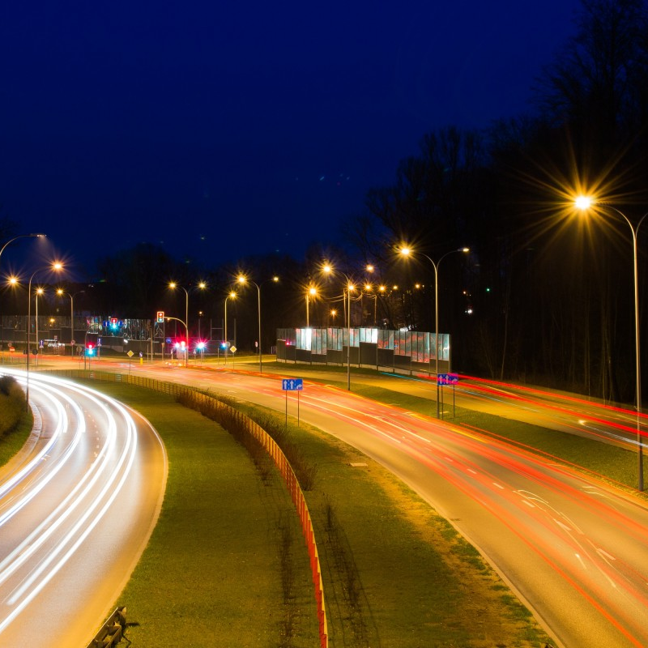
REALCHEM - Background
Ambitious Green Deal and zero pollution vision by 2050
  transport sector is required to implement wide-reaching changes.
Despite electrification, it is evident that for heavy-duty (HD) transport, non-road mobile machinery (NRMM), the shipping sector, and aviation, the need for combustion-based technologies remains
  HtE transport mode classification
Decarbonisation driven by a change from fossil fuels to low-carbon biofuels or electrofuels resembling currently used fuel
  E.g. methane (CNG, LNG), alcohols (ethanol, methanol), diesel, jet and marine fuels.
  Additionally, carbon-free fuel options cover ammonia (NH3) and hydrogen (H2)
Changes to combustion technologies and therefore also to the air pollutant emissions.

Slide 3
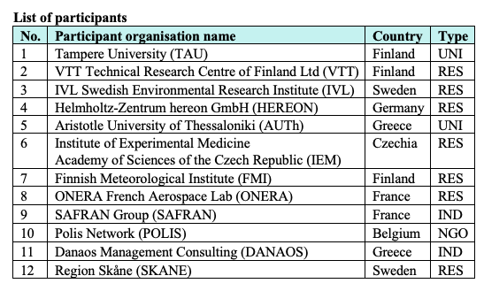
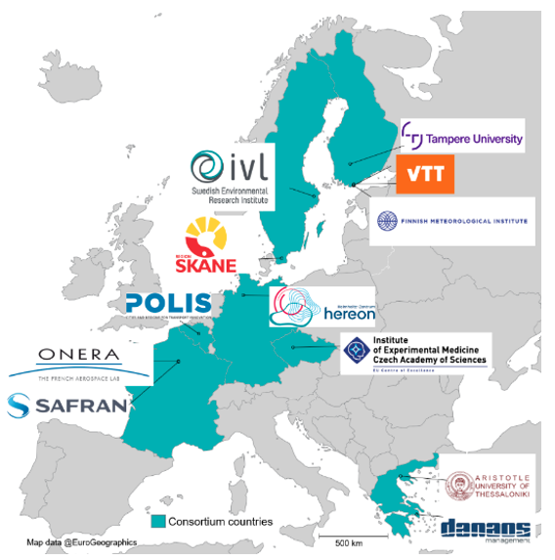
The REALCHEM consortium

Slide 4

Objectives
Produce robust, comprehensive, and actionable scientific data on the characteristics of emissions from low-carbon fuels in the Hard-to-Electrify transport modes
Understand the effect of introducing low-carbon fuels to the developing technology matrix on human health, climate, and the environment
Help technology developers and users to understand the emission formation and reduce the harmful pollution from engines using low-carbon fuels

Slide 5
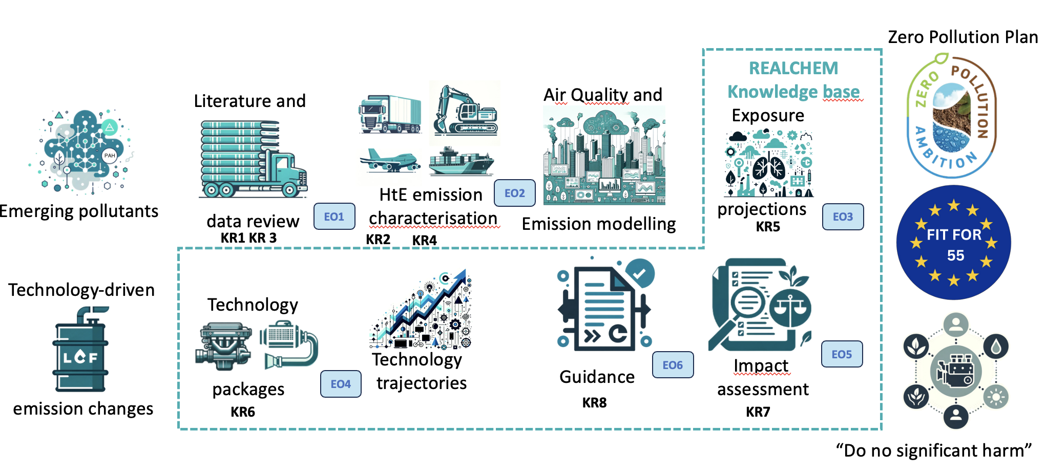
What will REALCHEM do?
Comprehensive Emission Characterization including emerging pollutants for low carbon fuels | Technology Packages to Mitigate Emerging Forms of Pollution | Updated projections of air pollution exposure and impacts on health and climate | Reliable scientific data and knowledge to guide future policy and technology choices

Slide 6



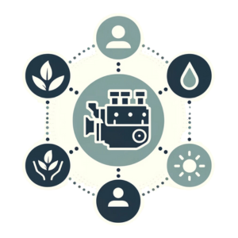



REALCHEM Components
Zero Pollution Plan
Emerging pollutants
WP8: Communication, Dissemination, Exploitation
WP1: Coordination
WP6: Technology packages, impact assessment and guidance
WP5: Air pollution & exposure projections
WP7: Data integration and synthesis / actionable knowledge
WP2-4: Filling in missing data
Pre-existing data on non-criteria pollutants
Pre-existing data on criteria pollutants
“Do no significant harm”
Experiments

Slide 7
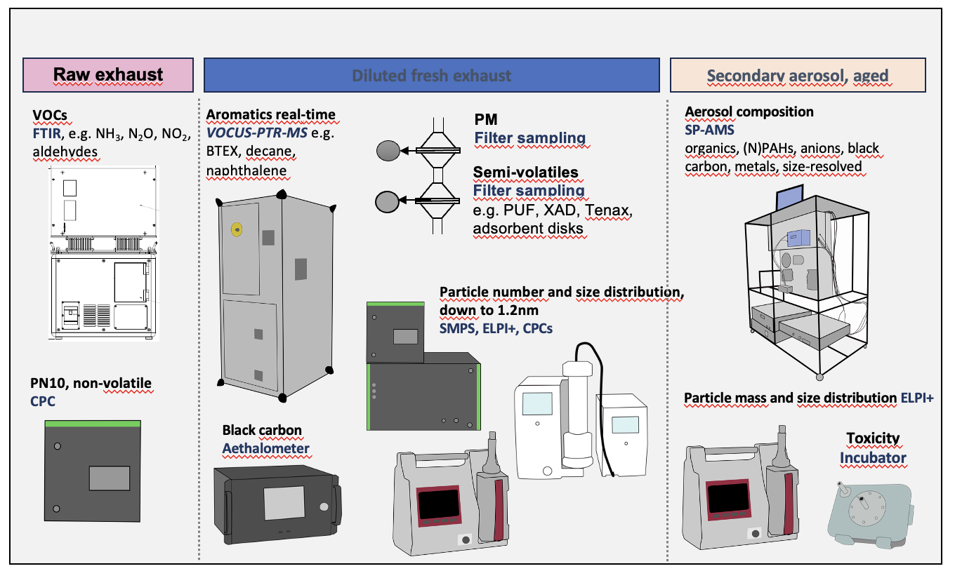

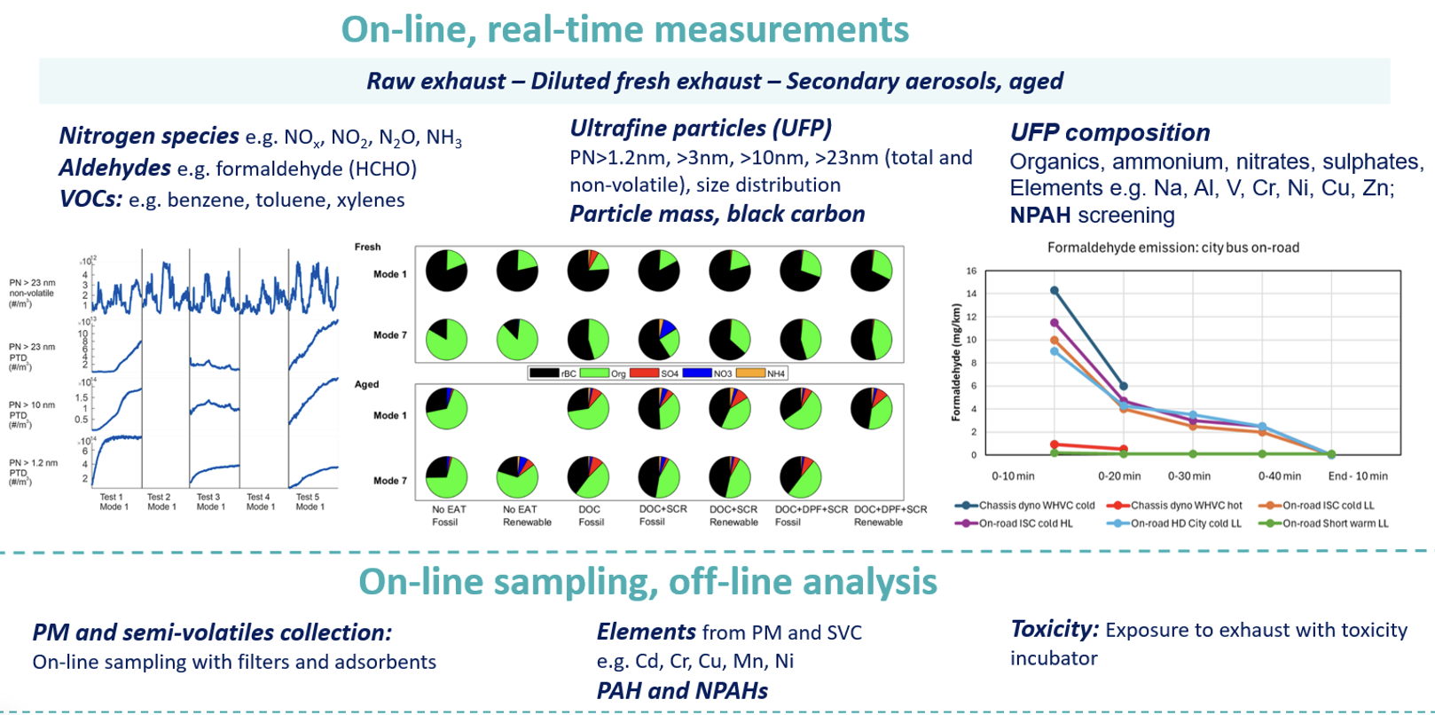



Experiments
Comprehensive measurement system throughout experiments
REALCHEM will experimentally characterise the emissions from engines, especially for emerging pollutants beyond WHO air quality quidelines (PN, UFP, BC, SecA), with similar measurement system for different modes
Dedicated experiments
Experiments will be performed in all three transport modes:
HD and NRMM – real-world and simulation
Shipping – on-board
Aviation – turboshaft engine with SAF
Health effects and toxicity
The toxicity of emissions from the REALCHEM sampling system will be analysed using a 3D exposure system with air-liquid interface (ALI)
Notes:
Explain quickly

Slide 8
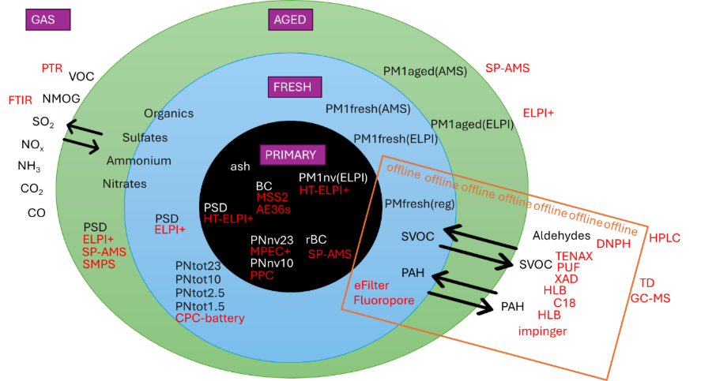
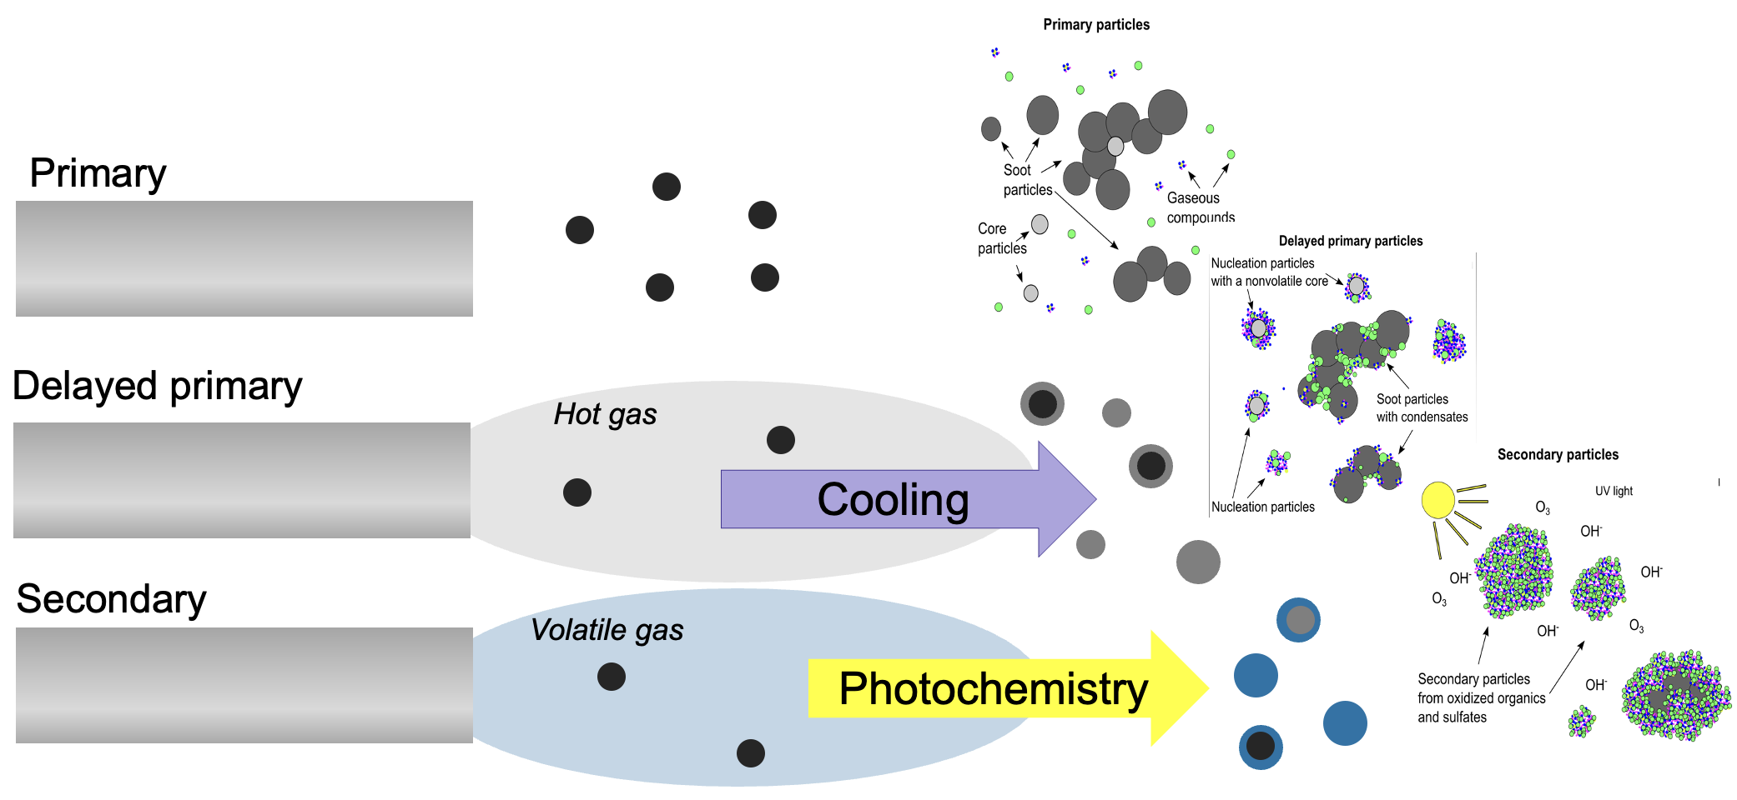
Complete emission
Fresh
Aged
Source: REALCHEM Deliverable D7.1
Regulated pollutants – Non-regulated pollutants – Emerging pollutants

Slide 9
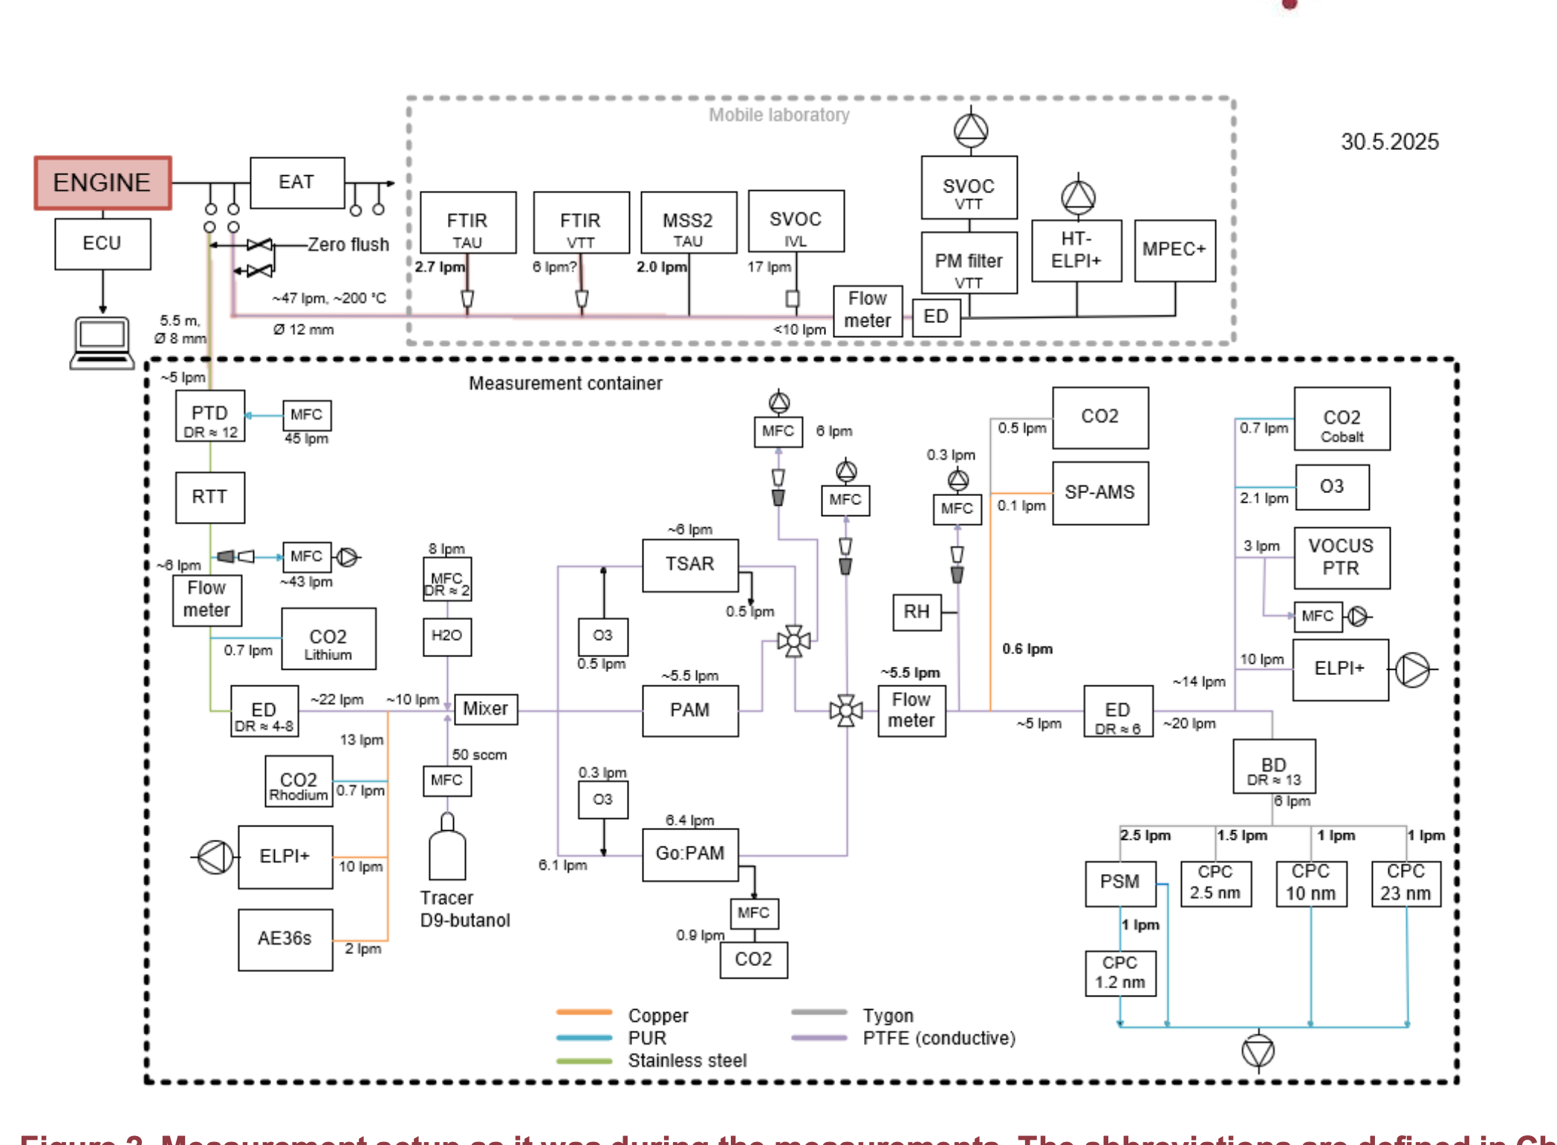
Setup testing and preparation campaign
Quality | PAM | TSAR | Go:PAM
UV (nm) | 185 | 254 | 254
Wall material | Aluminum | Quartz | Quartz
Volume (L) | 13.3 | 3.3 | 6.1
Flow (lpm) | 5.42 ± 0.04 | 5.940 ± 0.04 | 65.348 ± 0.04
Residence time (s) | 147 | 347 | 5779
Conical inlet | No | Yes | No
Funnel outlet | No | No | Yes
External O₃ generator | No | Yes | Yes, sometimes TSAR O3 generator
O₃ concen-tration (ppm) | 18.9 ± 10.8 | 38.9 ± 6.3 | 7.3 ± 3.7
Reference | Kang et al. (2007), Lambe et al. (2011) | Simonen et al. (2017) | Watne et al. (2018 )

Slide 10
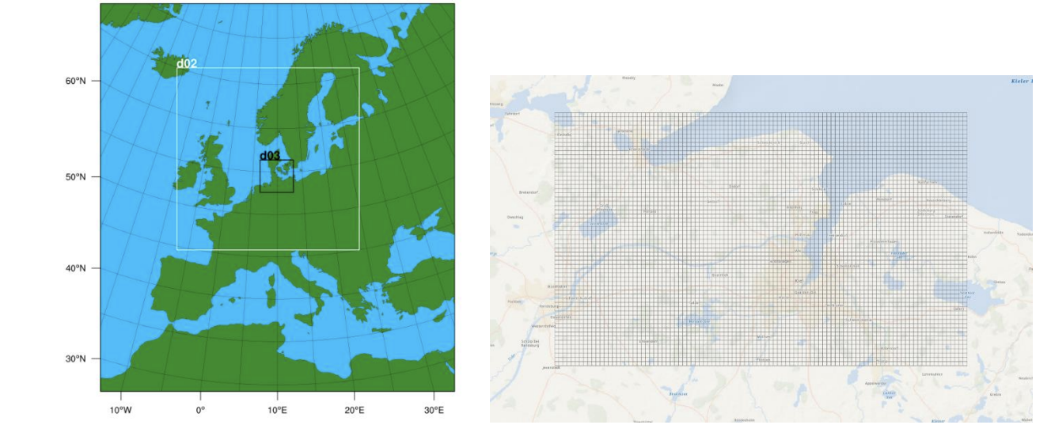
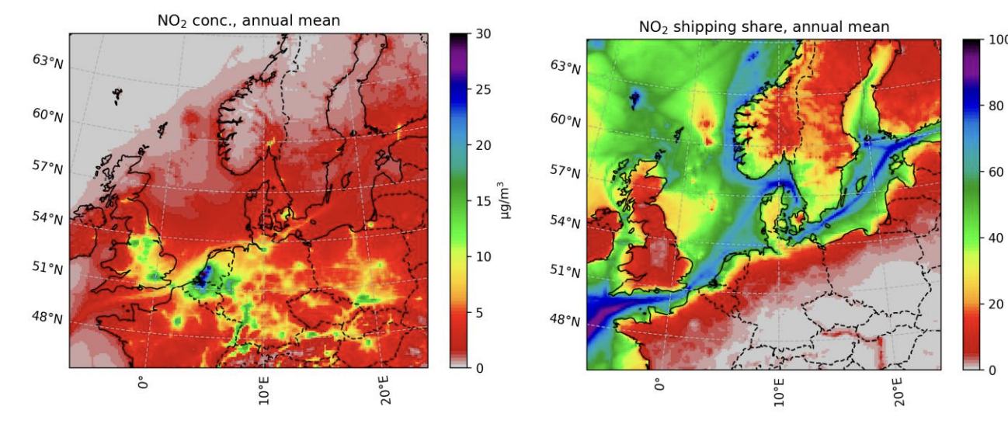

Modelling
Emission modelling
REALCHEM will make use of existing available data and inventories, complemented by own data for low-carbon fuels to generate relevant emission inventories
Chemistry transport modelling:
Spatially and temporally resolved concentrations of pollutants based on the emission input from inventories will be produced with EMEP and CMAQ models on a regional scale, and EPISODE-CityChem for city-scale.
Human exposure
We will use population data with CTM model results for estimating exposure, using high-resolution model data and combining with HR land-use information
Example modelling results from SCIPPER project using CMAQ modelling system

Slide 11
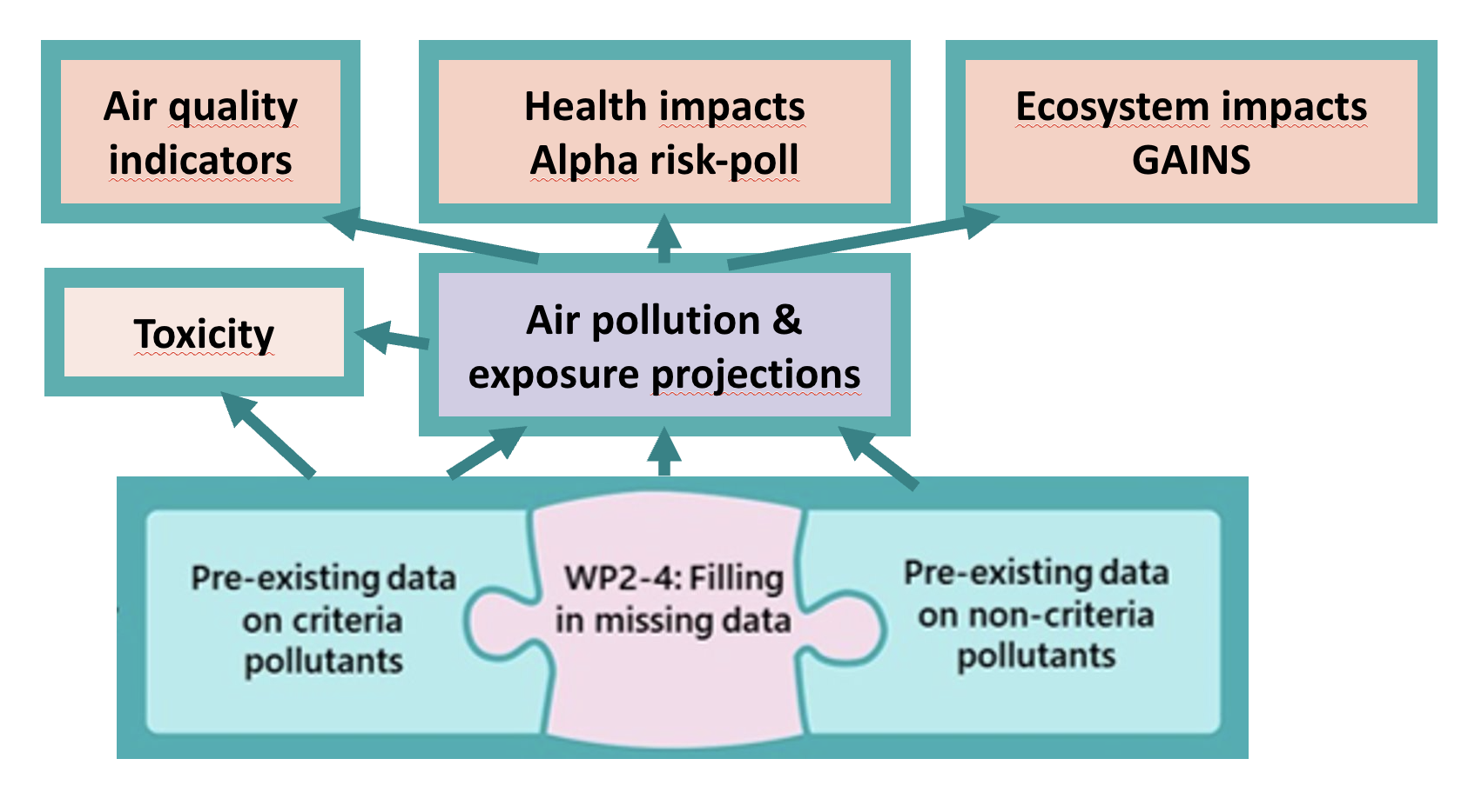
Impact Assessment

Slide 12
LCA emissions for fuel production pathways
Scope definition
Life cycle inventory data collection
Life cycle modelling
Life cycle impact assessment
Stakeholder consultation
Literature review
Legislative analysis
(Life cycle regulation at EU, ICAO, IMO, etc.)

Slide 13
Mitigation strategies for regulated and emerging pollutants
Literature search
Other projects
Mitigation Strategies
for the different low-carbon fuel/power train combinations relevant for shipping, aviation and heavy-duty.
Experiments
Stakeholders
*Special focus will be on operational emissions, energy efficiency and sustainability as well as the technical aspects coupled to the existing and upcoming emission and safety standards.

Slide 14
Technology packages with guiding principles
Experiments
Technology packages to mitigate emerging forms of pollution
HD& NRMM
Mitigation strategies
HD & NRMM
Shipping
Aviation
Shipping
Guiding principles for optimized design, operation and maintenance, evaluation of costs
Aviation
Stakeholder community consultation
HD& NRMM
Shipping
Aviation

Slide 15
Technology packages to mitigate emerging pollutants in different sectors
Power train
Electrification, hybridization
Engine development
Fuel cells
Liquid fuels (bio, synthetic)
SAF
Low carbon fuels
Alcohols (methanol, ethanol)
Ammonia
Biogas
Hydrogen
After-
treatment
Selective catalytic reduction
Diesel particulate filters
Oxidation catalysts
Carbon capture

Slide 16
Impact pathways
Target groups
Outcome
Impact
Vision 2050
Zero-pollution
Climate neutrality
Scientific data for policy-making
Scientific communities
Knowledge of ultrafine (2.5nm), emerging pollutants from combustion of LCF for all transport modes
Scientific knowledge guided policies reducing emissions and overall environmental impact
Policy-makers
Exposure projections up to 2050 and trade-off scenarios for decision-making
Authorities (Transport, Health Environment)
Air pollution exposure projections up to 2025 further updated by other scientists
Exposure projections guided policy-making and technology selection
OEM
Developers
Published principles based DNSH guided design, use and maintanance of technologies
Leadership of European transport sector is maintained while environmental impact is reduced
Guidance for technology choices
Operators
Operators of fleets/infrastructures (air/ports) use guidance in investment decision
Competitiveness of European transport sector is maintained
Citizens
Notes:
Modify so that we are not guiding participants too early

Slide 17
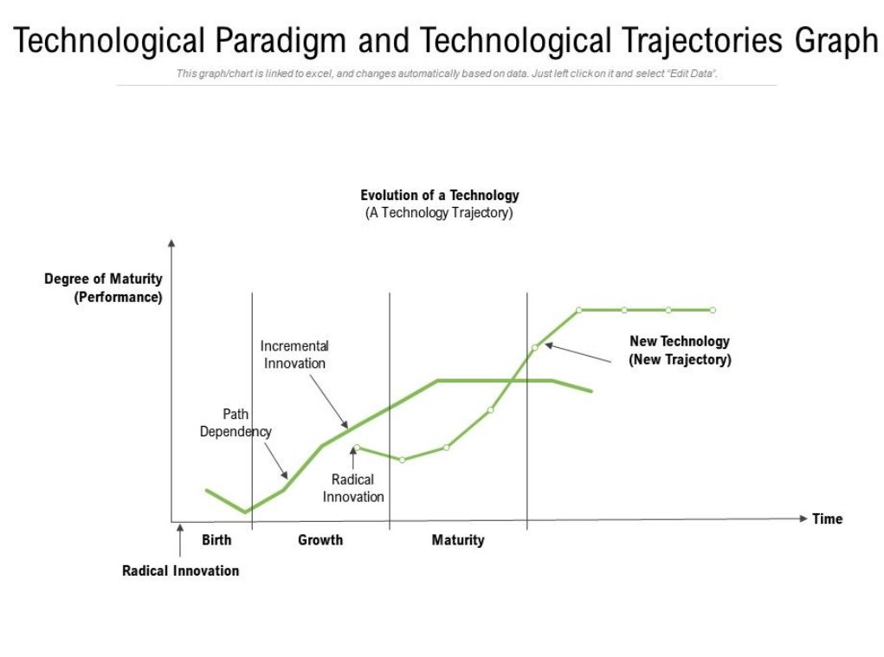
Technology trajectories
Influencing factors
Technological advancements:​
New discoveries and inventions can pave the way for new technological paths.​
Market demand:​
Consumer preferences and needs can drive the evolution of existing technologies or the development of new ones.​
Regulatory environment:​
Regulations and standards can shape the direction of technological development, particularly in areas like energy, transportation, and health.​
Other economic factors:​
Investment, competition, and cost-effectiveness play a crucial role in determining which technologies are adopted and how they evolve.
Definition:The path a technology follows through time T
echnology trajectories are most often used to represent the technology’s rate of performance improvement or its rate of adoption in the marketplace.

Slide 18
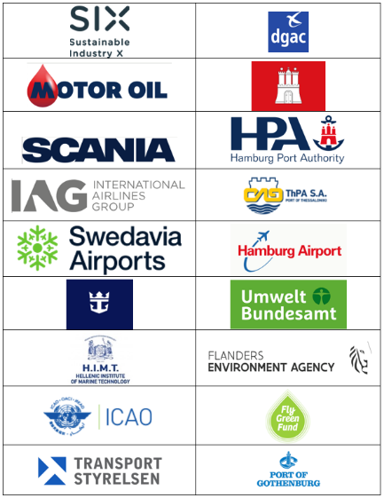
1st stakeholder meeting
Thu 13.11.2025
Zoom: 13:00-16:00 EET
Purpose: Stakeholder consultation: needs, technology trajectory development, mitigation strategies
Audience: REALCHEM target groups: scientists, policy-makers, OEM developers, transport operators
We have active of participation already, but still welcome participants of all transport mode representatives.
Project stakeholder community is also open for new members.

Slide 19

Acknowledgement
This project has received funding from the European Union’s Horizon Europe research and innovation programme under grant agreement No 101192395. Views and opinions expressed are however those of the author(s) only and do not necessarily reflect those of the European Union. Neither the European Union nor CINEA can be held responsible for them.

Slide 20

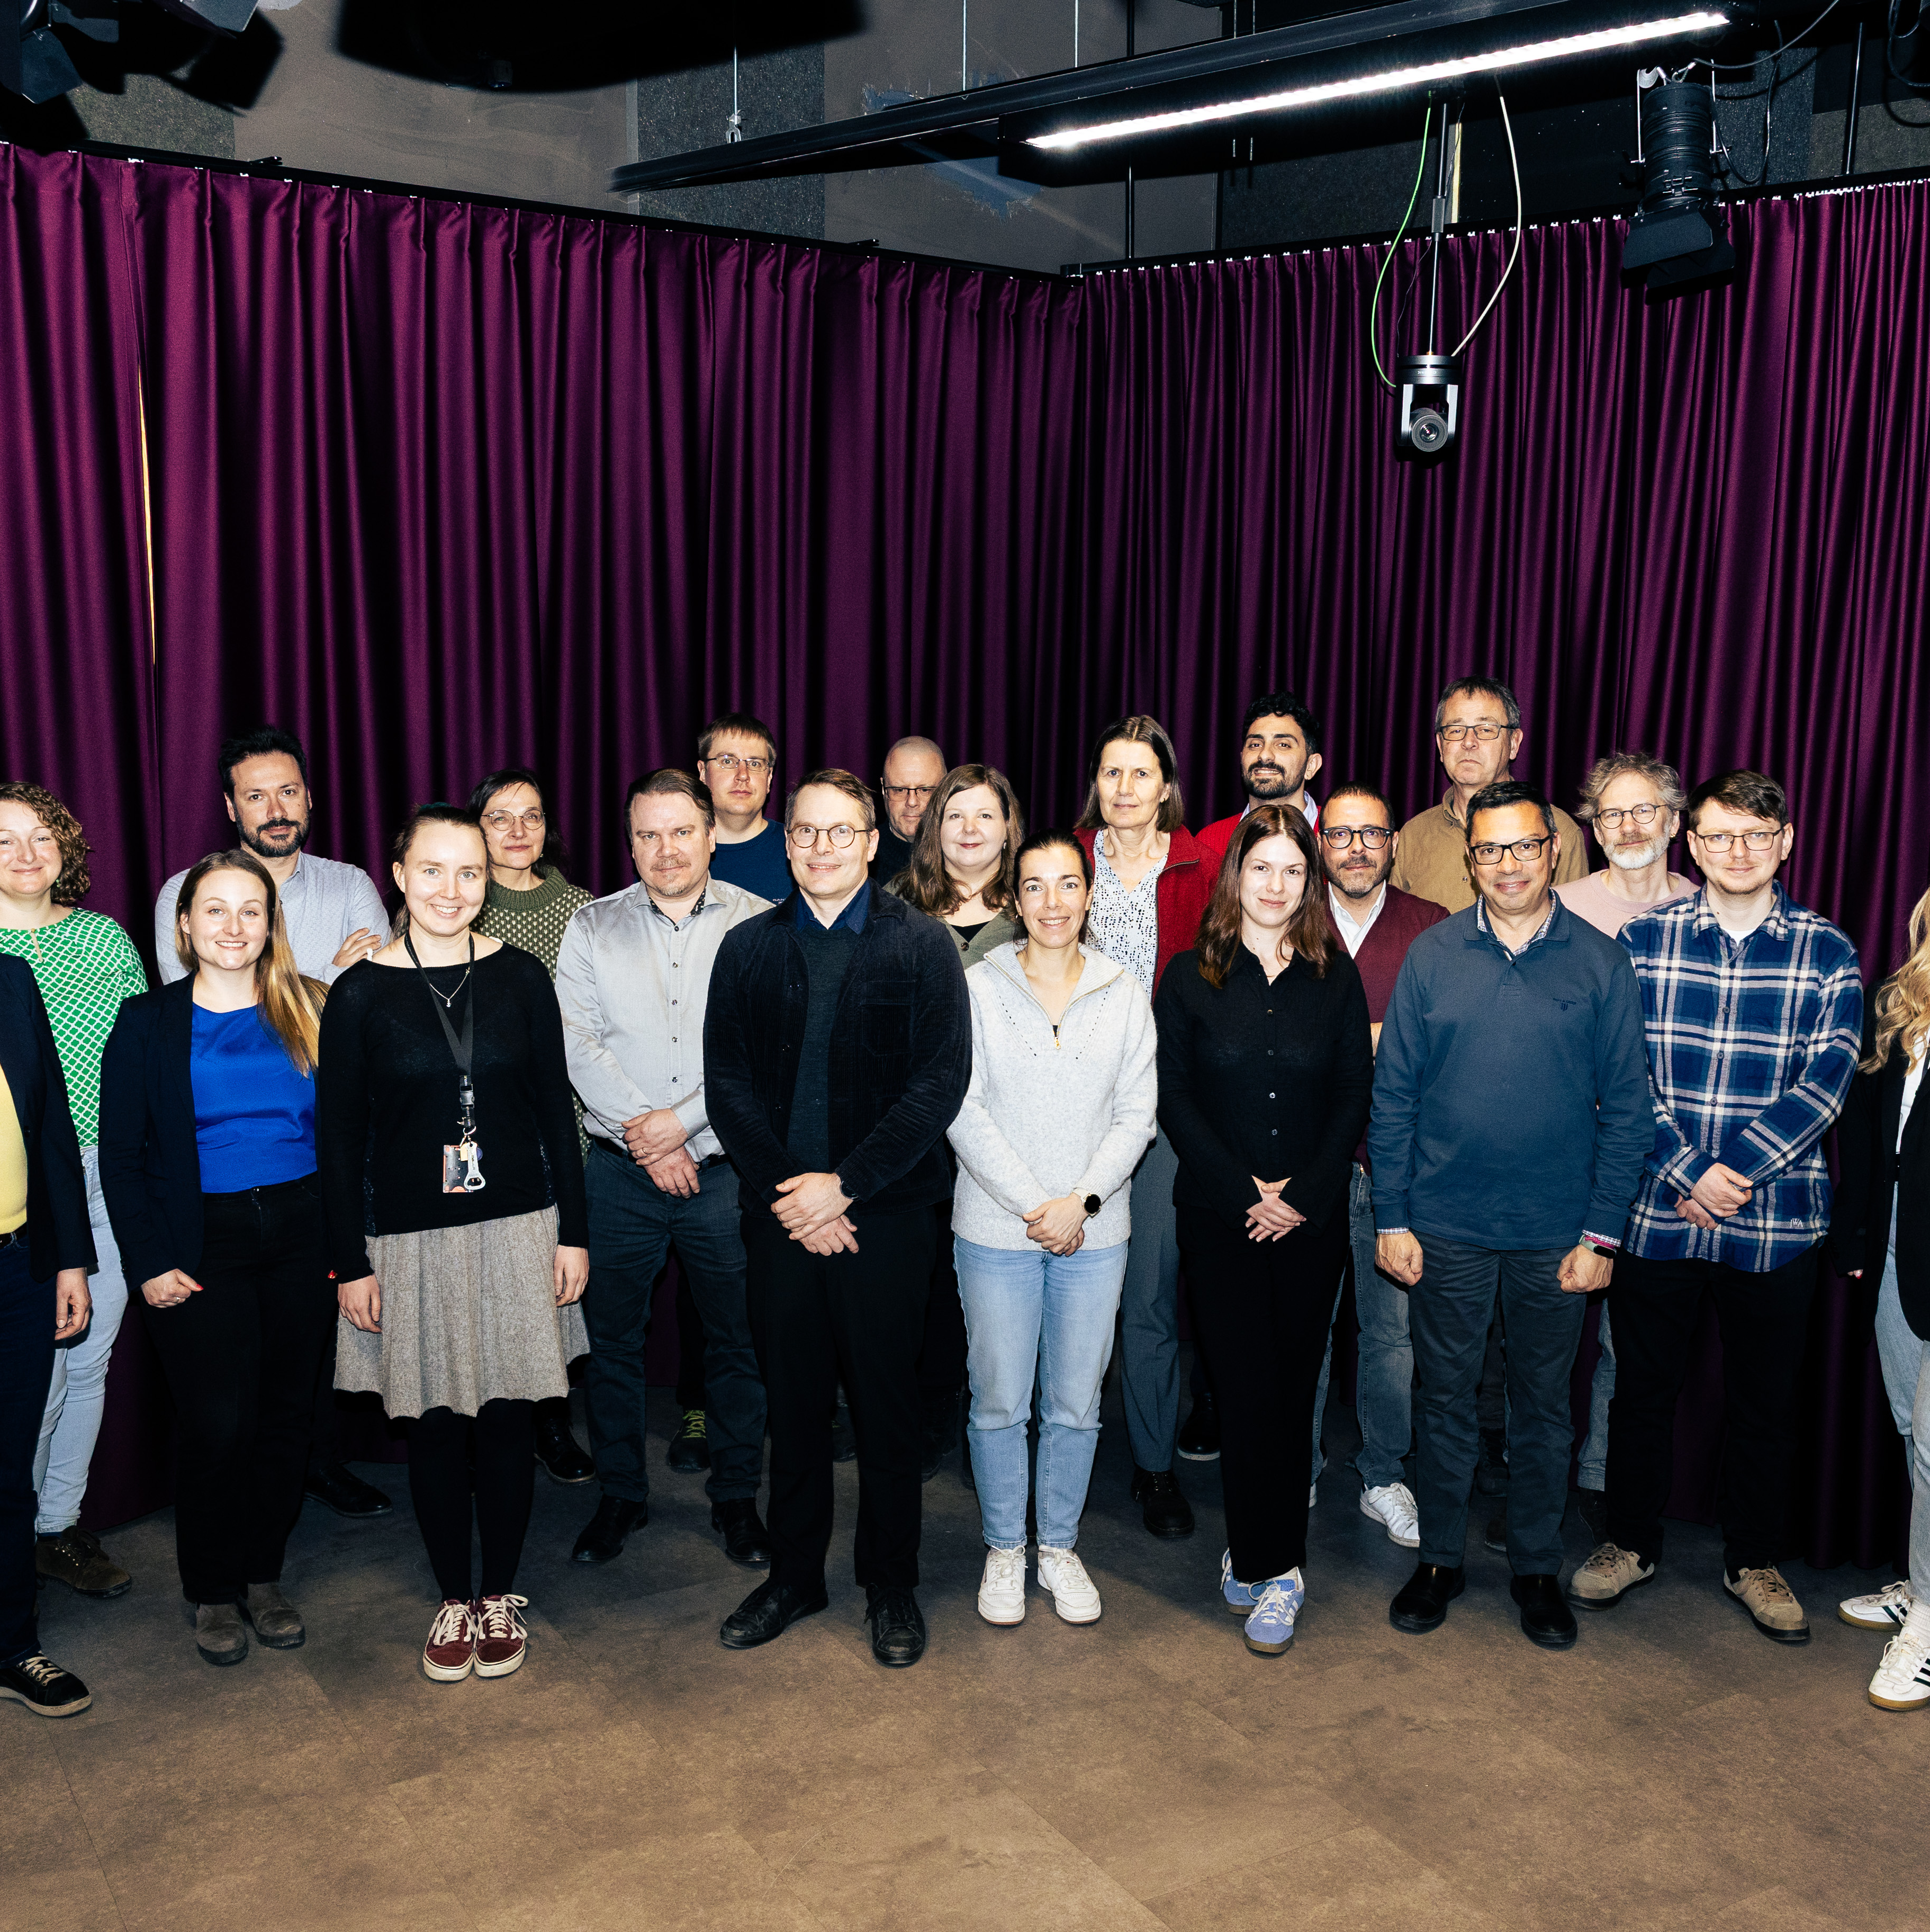
Project Coordinator – Prof. Miikka Dal Maso
miikka.dalmaso@tuni.fi
Communication Manager – Pedro Gomes
PGomes@polisnetwork.eu

